Slide 1

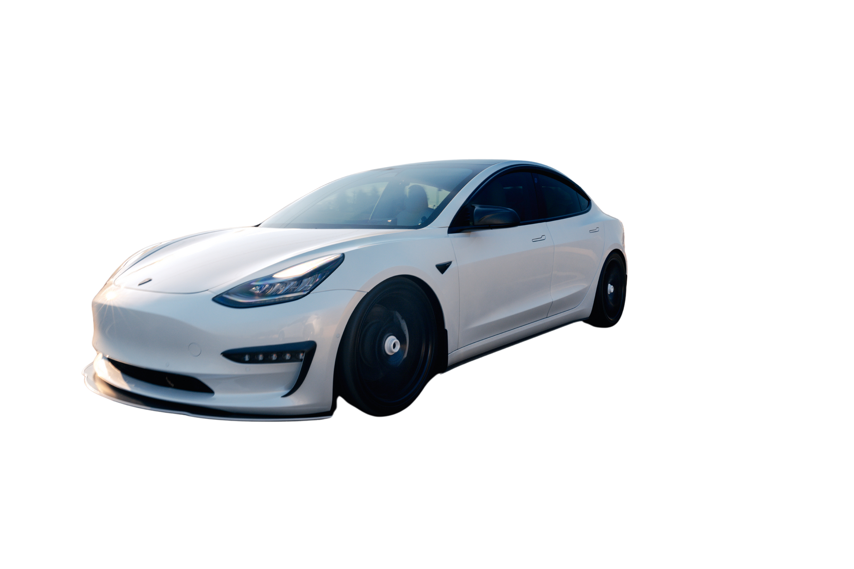

HOME
ABOUT US
SERVICES
TEST DRIVE
ELECTRIC VEHICLE DATA ANALYSIS
Presented By:
Abhishek

Slide 2
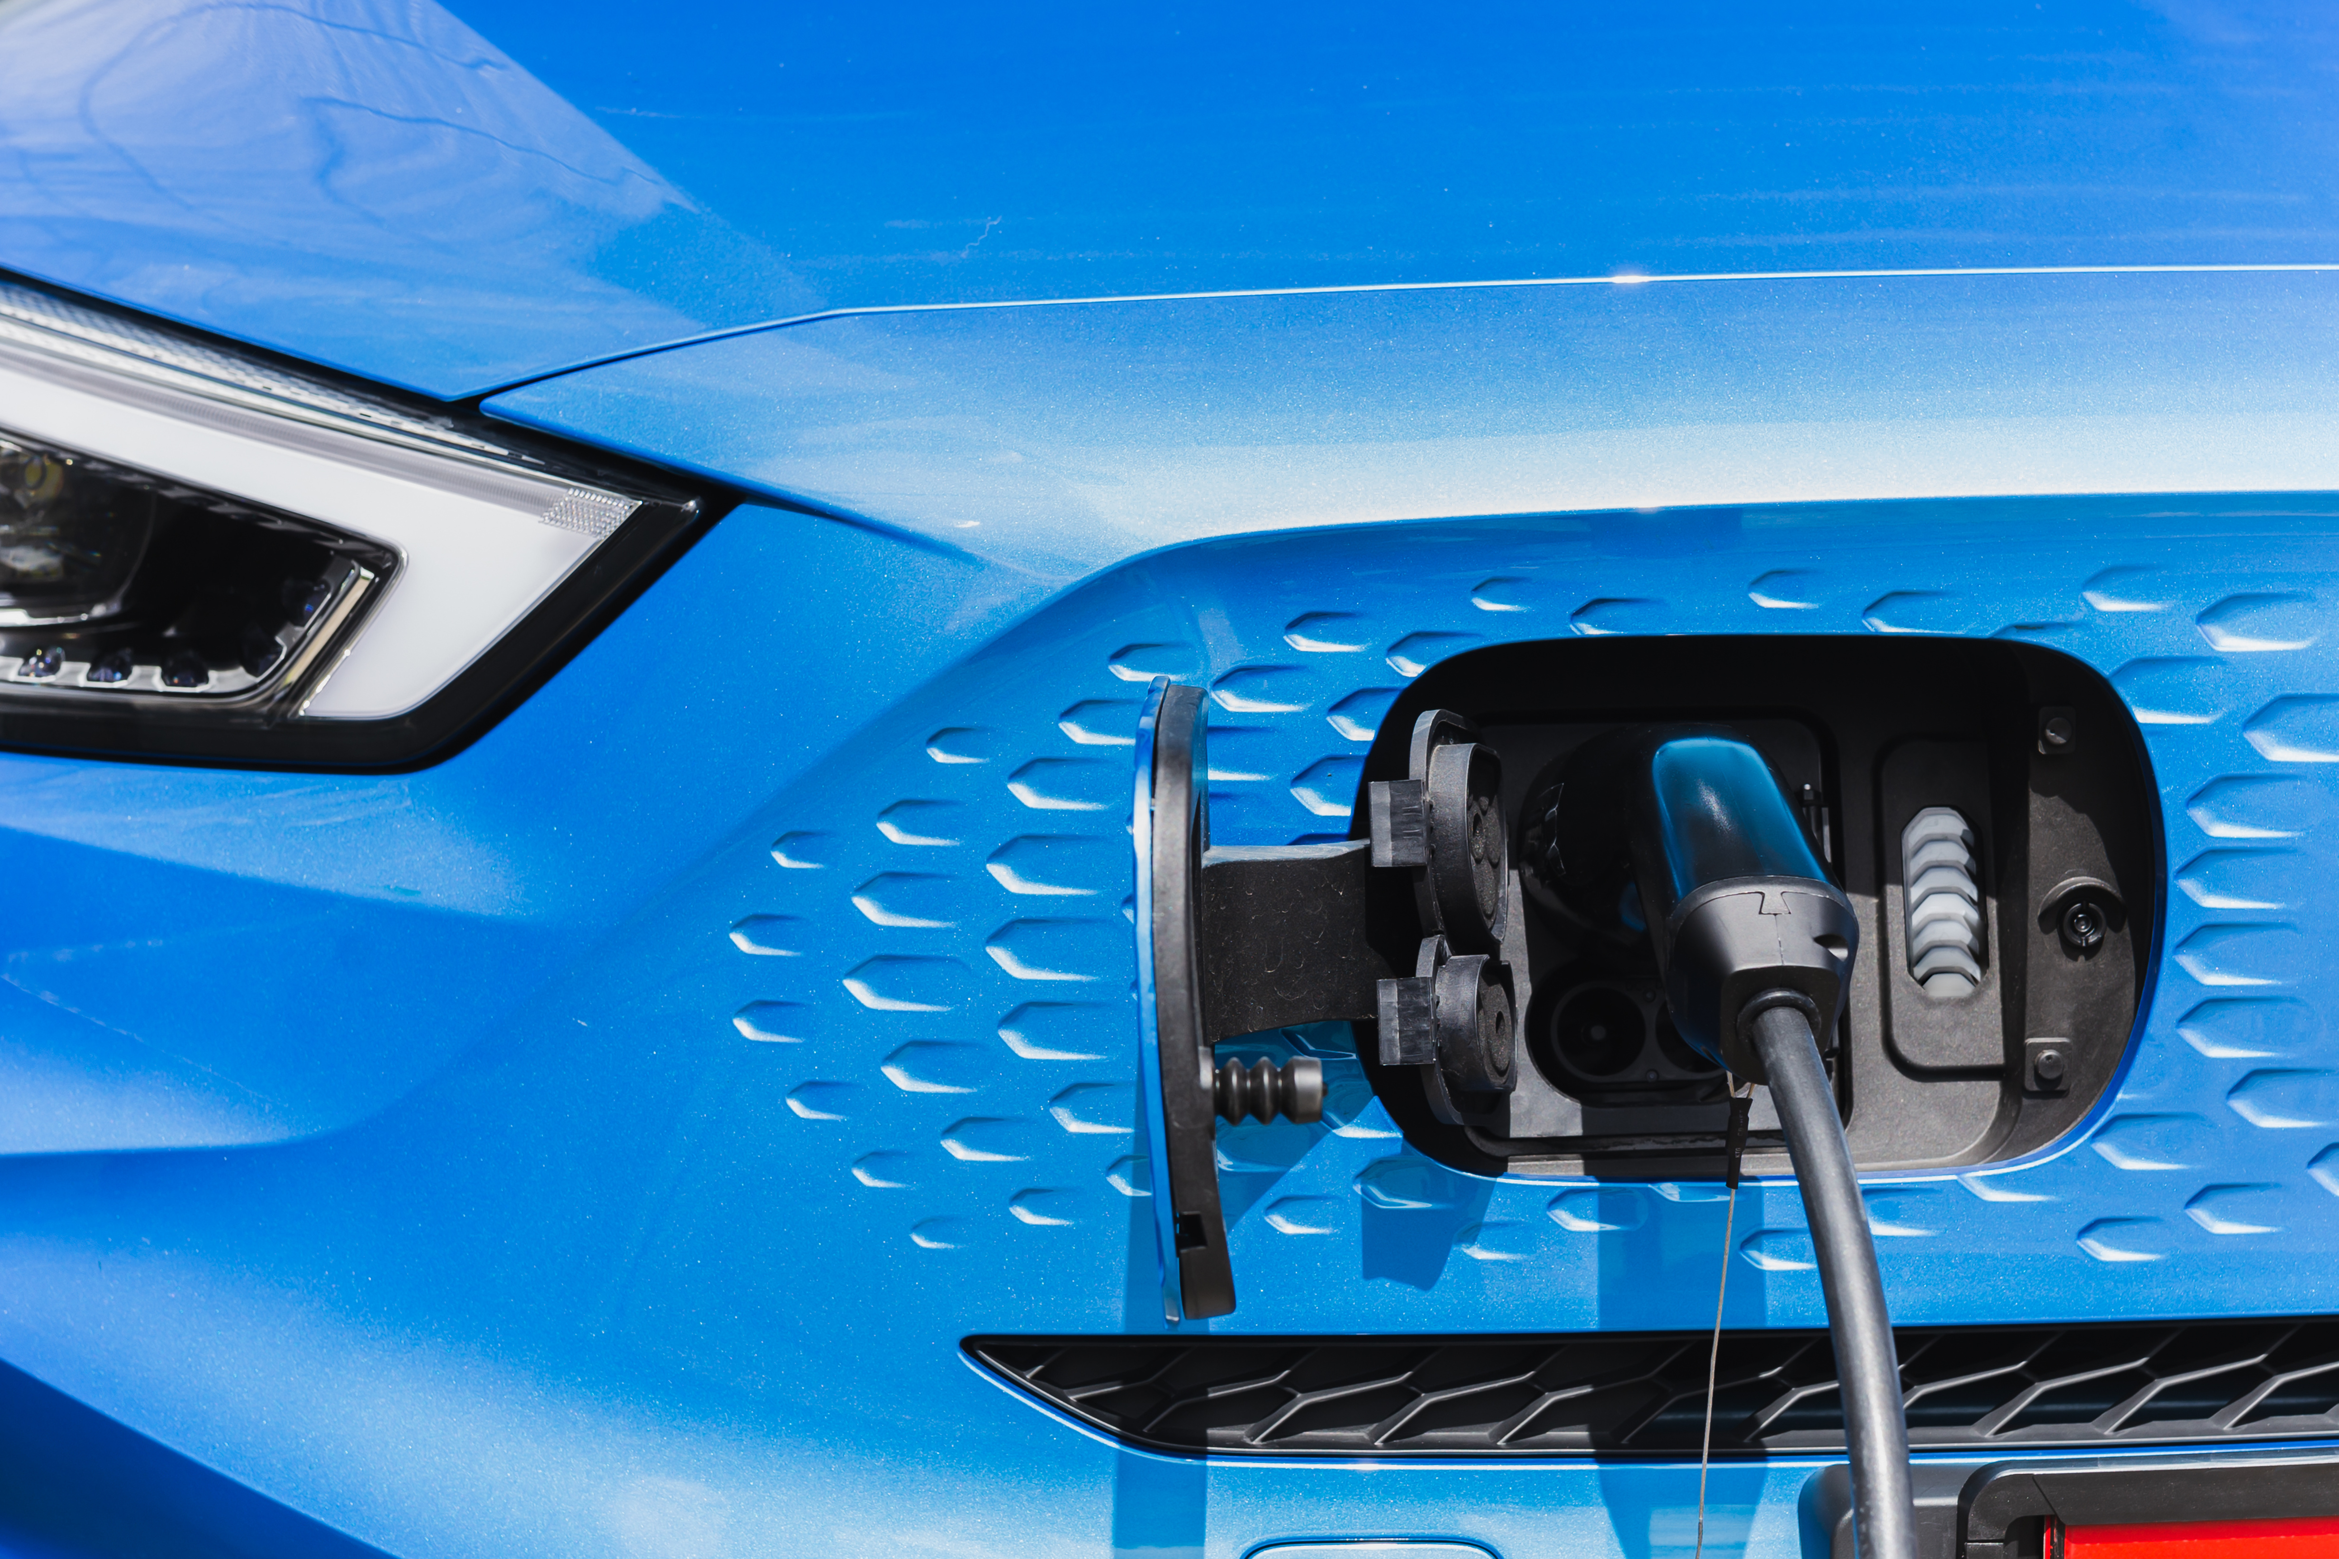
ABOUT US
SERVICES
TEST DRIVE
PROJECT OVERVIEW
• Analyzed EV dataset with 53 rows & 25 features.
• Included variables: price, battery capacity, range, engine power,energy consumption, dimensions, etc
.
• Goal: The goal was to understand what drives EV pricing, range, and efficiency, and to identify which vehicles offer the best value to customers.

Slide 3
ABOUT US
SERVICES
TEST DRIVE
OBJECTIVES
• Clean missing & skewed data.
• Identify EVs based on customer criteria.
• Detect outliers & analyze relationships.
• Build EV recommendation system.
• Perform hypothesis testing (Audi vs Tesla).
• Generate actionable insights for business.

Slide 4
ABOUT US
SERVICES
TEST DRIVE
DATA CLEANING & PREPROCESSING
• Used median imputation for skewed numerical features.
• Used mode imputation for 'Type of brakes'.
• Validated missing values post-cleaning.
• Visualized skewness using histograms & boxplots.

Slide 5
ABOUT US
SERVICES
TEST DRIVE
EXPLORATORY DATA ANALYSIS – KEY FINDINGS
• 12 EVs fit customer criteria (price ≤ 350k PLN, range ≥ 400 km).
• Audi and mercedes has highest average battery capacity.
• Tesla & Volkswagen provide high range at competitive price.
No outliers found in Energy Consumption.
Positive correlation between battery capacity & range.

Slide 6
ABOUT US
SERVICES
TEST DRIVE
EV RECOMMENDATION SYSTEM
• Built a Python class: EVRecommender.
• Inputs: budget, min range, min battery.
• Sorted on: highest range → lowest price.
• Output: Top 3 EV recommendations.
• Example: Tesla Model 3, VW ID.3 Pro S.

Slide 7
ABOUT US
SERVICES
TEST DRIVE
HYPOTHESIS TESTING – AUDI VS TESLA ENGINE POWER
• Tests performed: Shapiro-Wilk, Mann–Whitney U
• p-value > 0.05 → Fail to reject Null Hypothesis.
• Conclusion: No significant difference in engine power.
• Factors like range, price and charging speed differentiates it.

Slide 8
ABOUT US
SERVICES
TEST DRIVE
FINAL RECOMMENDATIONS
• improve efficiency rather than just battery size
• adjust pricing for low value-score models
• focus more on mid-range EVs

Slide 9
ABOUT US
SERVICES
TEST DRIVE
KEY SKILLS DEMONSTRATED
• Data Cleaning & Preprocessing.
• Exploratory Data Analysis.
• Statistical Testing.
• Python OOP for Recommender System.
• Business Insights and Recommendations.

Slide 10
HOME
ABOUT US
SERVICES
TEST DRIVE
THANK YOU

